Slide 1
Discovering hidden insights
Shiv Nadar University Chennai Coding Club
AI & ML

Slide 2
Agenda
Introduction
Visualization
Chart Types
Choosing the right chart types

Slide 3
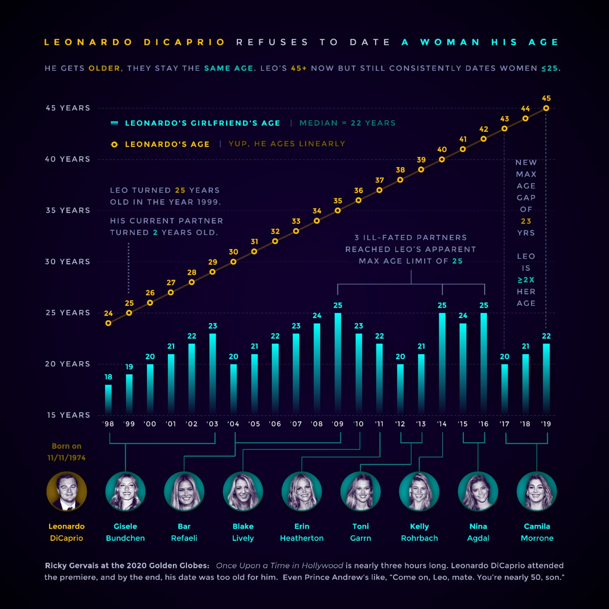
Introduction

Slide 4

Real Life Examples

Slide 5
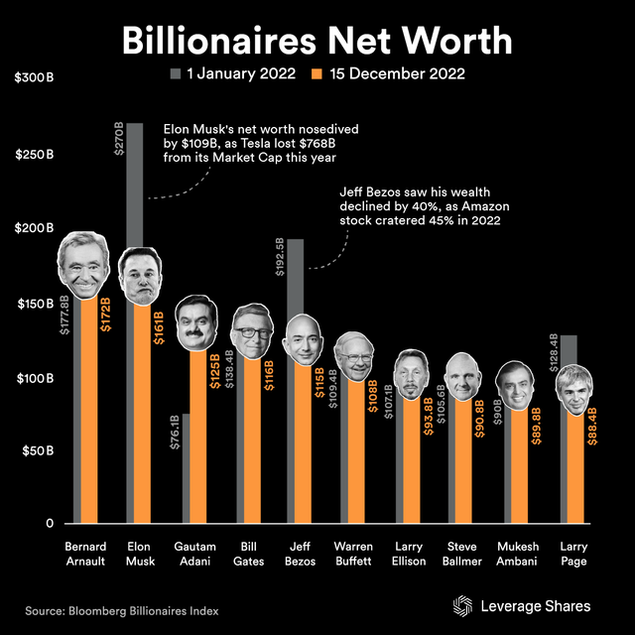
Bar Plot

Slide 6
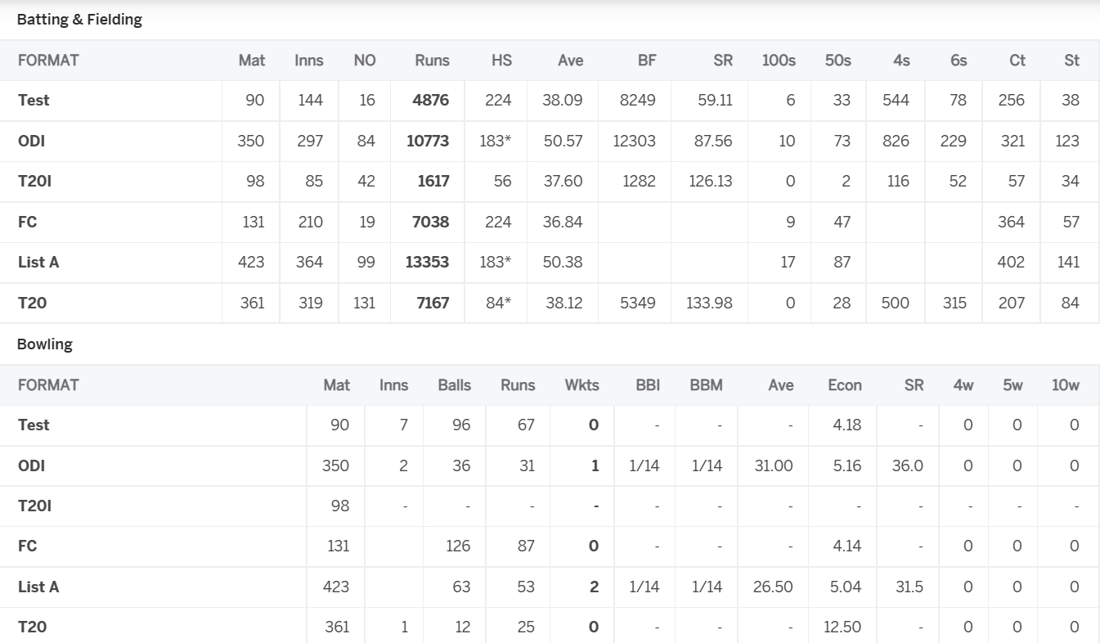
Tabular Data

Slide 7
Different Chart Types
Data Visualization

Slide 8
Scatter Plot
Crux
When to Use
relationship between two variables.
The first one is called independent. The second variable is called dependent because its values depend on the first variable.
When you need to observe and show relationships between two numeric variables.
When just want to visualize the correlation between 2 large datasets without regard to time.

Slide 9
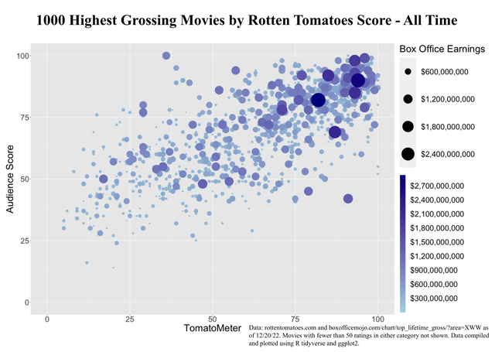
Example

Slide 10
Line Plot
Crux
When to Use
A line graph (also known as a line chart) is a graph used to visualize the values of something over a specified period of time.
Data points that display the values are connected by straight lines.
When you want to display trends.
When you want to represent trends for different categories over the same period of time and thus to show comparison.

Slide 11
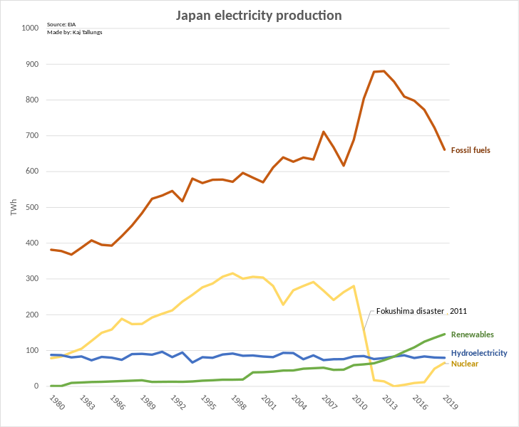
Example

Slide 12
Bar Chart
Crux
When to Use
A bar chart (also called bar graph) is a chart that represents data using bars of different heights.
The bars can be two types – vertical or horizontal. It doesn’t matter which type you use.
The bar chart can easily compare the data for each variable at each moment in time.
When you need to compare several different categories.
When you need to show how large data changes over time.

Slide 13
Example

Slide 14
Histogram Chart
Crux
When to Use
A histogram is a chart that plots the distribution of a numeric variable’s values as a series of bars.
Each bar typically covers a range of numeric values called a bin or class; a bar’s height indicates the frequency of data points with a value within the corresponding bin.
Histograms are good for showing general distributional features of dataset variables

Slide 15
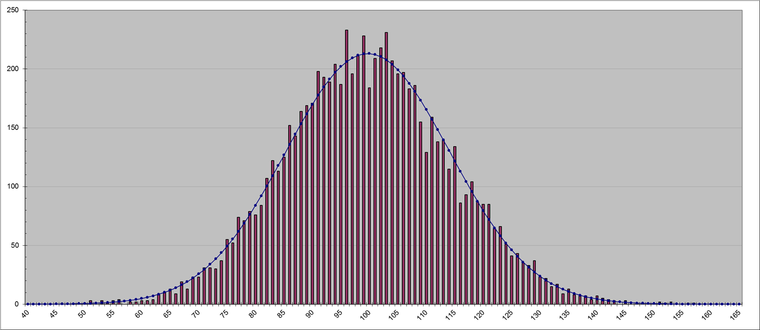
Example

Slide 16
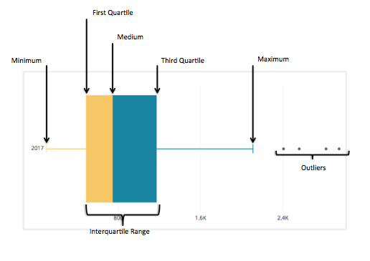
Box Plot
Crux
When to Use
A Box Plot is the visual representation of the statistical five number summary of a given data set.
To detect Outliers, present in the particular features

Slide 17
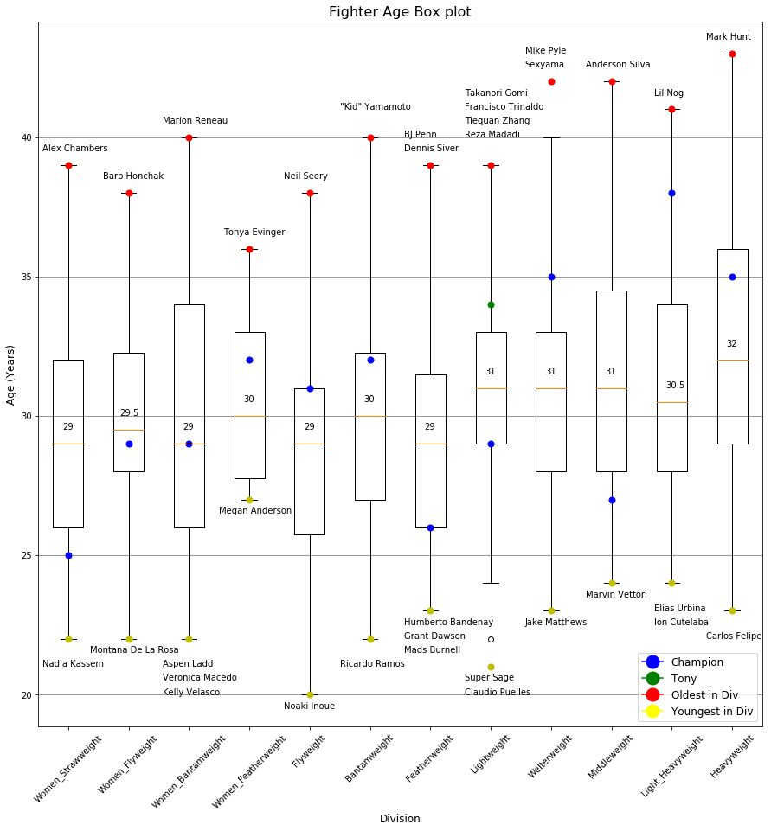
Example

Slide 18
Violin Plot
Crux
When to Use
Violin Plot is a method to visualize the distribution of numerical data of different variables.
It is similar to Box Plot but with a rotated plot on each side, giving more information about the density estimate on the y-axis.
When you need in-depth detail of the feature.

Slide 19
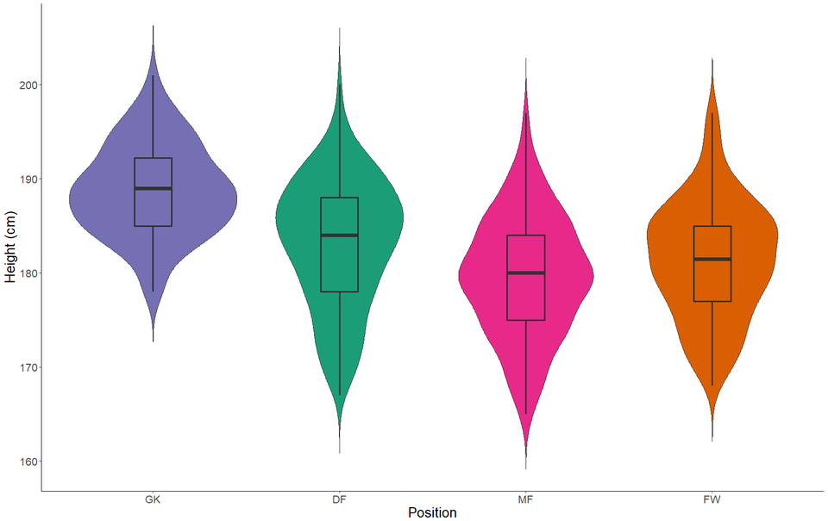
Example

Slide 20
KDE Plot
Crux
When to Use
KDE Plot described as Kernel Density Estimate is used for visualizing the Probability Density of a continuous variable.
It is an effort to analyse the model data to understand how the variables are distributed.

Slide 21
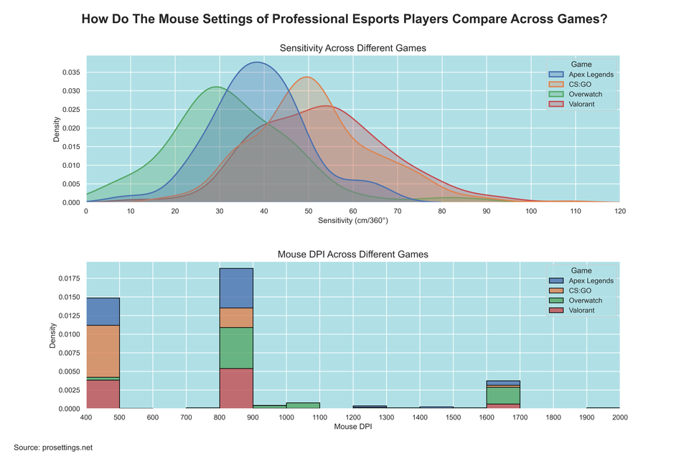
Example

Slide 22
Choosing the Charts
Charts for showing change over
time
For showing part to whole
composition
How is data distributed
these charts mostly have time on the horizontal axis.
the feature of interest on the vertical axis
Line chart
Bar chart
Box plot
sometimes we would like to know about the components that comprise the total.
pie chart.
donut chart.
stacked bar chart.
bar chart.
Histogram.
density curve.
boxplots
violin plots.

Slide 23
Choosing the Charts
Charts for comparing values
Charts for observing relationships
between variables
bar chart
grouped bar chart
line chart
box plot
violin plot
scatter plots
bubble plots
heat map
pair plots

Slide 24
THANK YOU
MUTHU PALANIAPPAN M
ASHVANTH S

